Slide 1
Chapter: Requirement Engineering

Slide 2
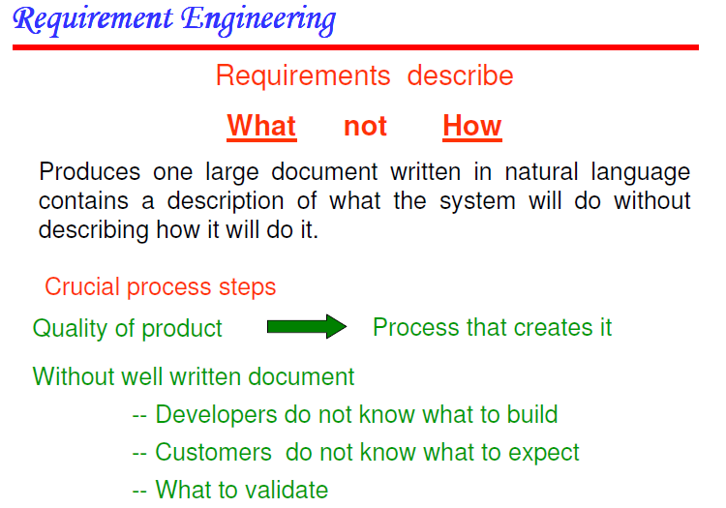

Slide 3
Software Requirement
Requirement:
attribute to be possessed by the product or a function to be performed by the product.
performance standard for the attribute or function.
measuring process to be used in verifying that the standard has been met.
Software Requirement
Need, the software is expected to meet

Slide 4
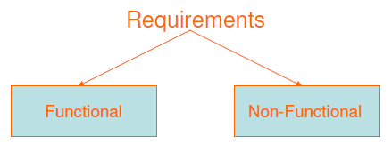
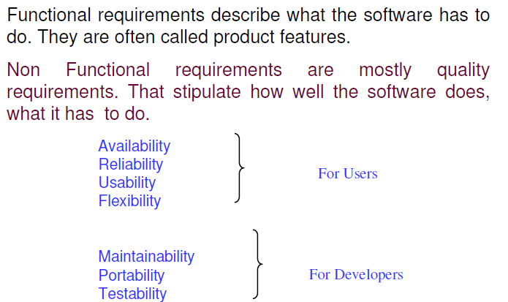
Types of Software Requirement

Slide 5
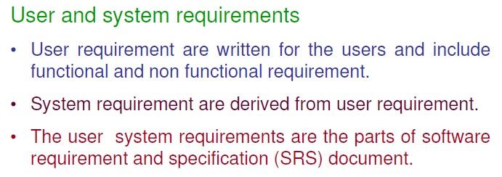

Slide 6
Sources of Software Requirement
Stakeholder/Buyers
User/beneficiary
Operator
Domain Experts
Developer
Automated Tools
Past Experience/Case Studies
Tester
Other concerned people

Slide 7
Software Requirement Engineering
A Branch of Software Engineering
Focus on real world goals, functions, constraints, limitations and effects of implementation and use of a software system.
The main task is to determine explicitly the stated or implied needs, a system has to fulfill.

Slide 8
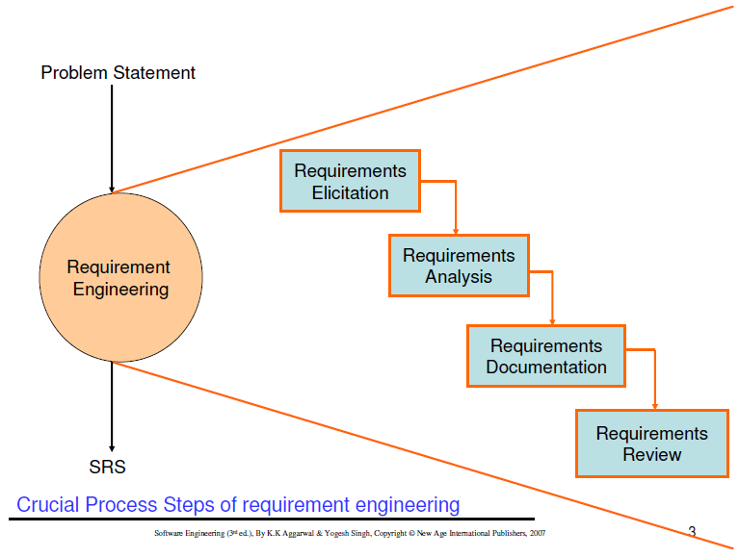

Slide 9
SRE Activities and Techniques
Context Analysis
Requirement Elicitation
Interview, Surveys, Questionnaire, data Mining, Brain Storming, Market Analysis
Requirement Assessment/Analysis
SSA, OOA
Requirement Verification, Testing and Review
Software Requirement Specification

Slide 10
Characteristics of a Good Requirement
Clear and Unambiguous
standard structure
has only one possible interpretation
Not more than one requirement in one sentence
Correct
A requirement contributes to a real need
Understandable
A reader can easily understand the meaning of the requirement
Verifiable
A requirement can be tested
Complete
Consistent
Traceable

Slide 11
Why is Getting Good Requirements Hard?
Stakeholders don’t know what they really want.
Stakeholders express requirements in their own terms.
Different stakeholders may have conflicting requirements.
Organisational and political factors may influence the system requirements.
The requirements change during the RE process. New stakeholders may emerge and the business environment change.

Slide 12
Requirements Engineering Tasks
Inception —Establish a basic understanding of the problem and the nature of the solution.
Elicitation —Draw out the requirements from stakeholders.
Elaboration (Highly structured)—Create an analysis model that represents information, functional, and behavioral aspects of the requirements.
Negotiation—Agree on a deliverable system that is realistic for developers and customers.
Specification—Describe the requirements formally or informally.
Validation —Review the requirement specification for errors, ambiguities, omissions, and conflicts.
Requirements management —Manage changing requirements.

Slide 13
Inception
Inception— Ask “context-free” questions that establish …
Basic understanding of the problem
The people who want a solution
The nature of the solution that is desired, and
The effectiveness of preliminary communication and collaboration between the customer and the developer

Slide 14
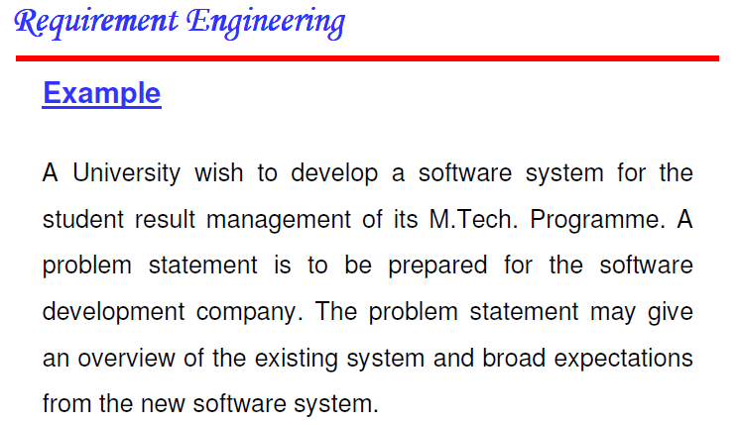

Slide 15
Elicitation
Elicitation - elicit requirements from customers, users and others.
Find out from customers, users and others what the product objectives are
what is to be done
how the product fits into business needs, and
how the product is used on a day to day basis

Slide 16
Why Requirement elicitation is difficult?
Problems of scope:
The boundary of the system is ill-defined.
Customers/users specify unnecessary technical detail that may confuse rather than clarify objectives.
Problem of understanding:
Customers are not completely sure of what is needed.
Customers have a poor understanding of the capabilities and limitations of the computing environment.
Customers don’t have a full understanding of their problem domain.
Customers have trouble communicating needs to the system engineer.
Customers omit detail that is believed to be obvious.
Customers specify requirements that conflict with other requirements.
Customers specify requirements that are ambiguous or not able to test.
Problems of volatility:
Requirement change over time.

Slide 17
Elaboration
Focuses on developing a refined technical model of software functions, features, and constraints using the information obtained during inception and elicitation
Create an analysis model that identifies data, function and behavioral requirements.
It is driven by the creation and refinement of user scenarios that describe how the end-user will interact with the system.
Each event parsed into extracted.
End result defines informational, functional and behavioral domain of the problem

Slide 18
Negotiation
Negotiation - agree on a deliverable system that is realistic for developers and customers
Requirements are categorized and organized into subsets
Relations among requirements identified
Requirements reviewed for correctness
Requirements prioritized based on customer needs
Negotiation about requirements, project cost and project timeline.
There should be no winner and no loser in effective negotiation.

Slide 19
Specification
Specification – Different things to different people.
It can be –
Written Document
A set of graphical models,
A formal mathematical models
Collection of usage scenario.
A prototype
Combination of above.
The Formality and format of a specification varies with the size and the complexity of the software to be built.
For large systems, written document, language descriptions, and graphical models may be the best approach.
For small systems or products, usage scenarios

Slide 20
Validation
Requirements Validation - formal technical review mechanism that looks for
Errors in content or interpretation
Areas where clarification may be required
Missing information
Inconsistencies (a major problem when large products or systems are engineered)
Conflicting or unrealistic (unachievable) requirements.

Slide 21
Requirement Management
Set of activities that help project team to identify, control, and track requirements and changes as project proceeds
Requirements begin with identification. Each requirement is assigned a unique identifier. Once requirement have been identified, traceability table are developed.
Traceability Table:
Features traceability table - shows how requirements relate to customer observable features
Source traceability table - identifies source of each requirement
Dependency traceability table - indicate relations among requirements
Subsystem traceability table - requirements categorized by subsystem
Interface traceability table - shows requirement relations to internal and external interfaces
It will help to track, if change in one requirement will affect different aspects of the system.

Slide 22
Initiating Requirements Engineering Process
Identify stakeholders
Stakeholder can be “anyone who benefits in a direct or indirect way from the system which is being developed”
Ex. Business manager, project manager, marketing people, software engineer, support engineer, end-users, internal-external customers, consultants, maintenance engineer.
Each one of them has different view of the system.
Recognize multiple points of view
Marketing group concern about feature and function to excite potential market. To sell easily in the market.
Business manager concern about feature built within budget and will be ready to meet market.
End user – Easy to learn and use.
SE – product functioning at various infrastructure support.
Support engineer – Maintainability of software.
Role of RE is to categorize all stakeholder information in a way that there could be no inconsistent or conflict requirement with one another

Slide 23
Work toward collaboration
RE identify areas of commonality (i.e. Agreed requirement) and areas of conflict or inconsistency.
It does not mean requirement defined by committee. It may happened they providing just view of their requirement.
Business manager or senior technologist may make final decision.
Asking the first questions
Who is behind the request for this work?
Who will use the solution?
What will be the economic benefit of a successful solution
Is there another source for the solution that you need?
These questions will help – stakeholder interest in the software & measurable benefit of successful implementation.

Slide 24
Asking the question
Next set of questions – better understanding of the problem.
What business problem (s) will this solution address?
Describe business environment in which the solution will be used?
will performance or productivity issues affect the solution is approached?
Final set of questions – Effectiveness of communication
Are my questions relevant to the problem?
Am I asking too many questions?
Can anyone else provide additional information?
should I be asking you anything else?

Slide 25
Eliciting Requirement
Approach for eliciting requirement:
Collaborative Requirement Gathering
Quality Function Deployment
User Scenarios
Elicitation Work Products

Slide 26
Collaborative Requirement Gathering
Meetings are attended by all interested stakeholders.
Rules established for preparation and participation.
Agenda should be formal enough to cover all important points, but informal enough to encourage the free flow of ideas.
A facilitator controls the meeting.
A definition mechanism (blackboard, flip charts, etc.) is used.
During the meeting:
The problem is identified.
Elements of the solution are proposed.
Different approaches are negotiated.
A preliminary set of solution requirements are obtained.
The atmosphere is collaborative and non-threatening.
Flow of event – Outline the sequence of events occurs
Requirement gathering meeting ( initial meeting)
During meeting
Follow the meeting.

Slide 27
Collaborative requirement gathering (contd.)
In initial meeting, distribute “Product request” (defined by stakeholder) to all attendee.
Based on product request, each attendee is asked to make
List of objects (Internal or external system objects)
List of services( Processes or functions)
List of constraints ( cost, size, business rules) and performance criteria( speed, accuracy) are developed.
Collect lists from everyone and combined.
Combined list eliminates redundant entries, add new ideas , but does not delete anything.
Objective is to develop a consensus list in each topic area (objects, services, constraints and performance).
Based on lists, team is divided into smaller sub-teams : each works to develop mini-specification for one or more entries on each of the lists.

Slide 28
Collaborative requirement gathering (Contd.)
Each sub-team the presents its mini-specification to all attendees for discussion. Addition, deletion and further elaboration are made.
Now each team makes a list of validation criteria for the product and present to team.
Finally, one or more participants is assigned the task of writing a complete draft specification.

Slide 29
Quality Function Deployment
It is a technique that translate the needs of the customer into technical requirement for software.
Concentrates on maximizing customer satisfaction.
QFD emphasizes – what is valuable to the customer and then deploys these values throughout the engineering process.
Three types of requirement:
Normal Requirements – reflect objectives and goals stated for product. If requirement are present in final products, customer is satisfied.
Expected Requirements – customer does not explicitly state them. Customer assumes it is implicitly available with the system.
Exciting Requirements- Features that go beyond the customer’s expectation.
During meeting with customer –
Function deployment determines the “value” of each function required of the system.
Information deployment identifies data objects and events and also tied with functions.
Task deployment examines the behavior of the system.
Value analysis determines the priority of requirements during these 3 deployments.

Slide 30
User Scenario
It is difficult to move into more software engineering activities until s/w team understands how these functions and features will be used by diff. end-users.
Developers and users create a set of usage threads for the system to be constructed
A use-case scenario is a story about how someone or something external to the software (known as an actor) interacts with the system.
Describe how the system will be used
Each scenario is described from the point-of-view of an “actor”—a person or device that interacts with the software in some way

Slide 31
Elicitation Work Products
Elicitation work product will vary depending upon the size of the system or product to be built.
Statement of need and feasibility.
Statement of scope.
List of participants in requirements elicitation.
Description of the system’s technical environment.
List of requirements and associated domain constraints.
List of usage scenarios.
Any prototypes developed to refine requirements.

Slide 32
Software Prototype
Prototype constructed for customer and developer assessment.
In some circumstances construction of prototype is require in beginning of analysis. (To derive requirement effectively)
Selecting Prototype Approach
Close ended (Throwaway Approach)
Open ended (Evolutionary Approach)
Close Ended – It serves as a rough demonstration of requirement. It is then discarded, and the software engineered using a different paradigm.
Open Ended - uses the prototype as the first part of an analysis activity that will be continued into design and construction. The prototype of the software is the first evolution of the finished system.

Slide 33
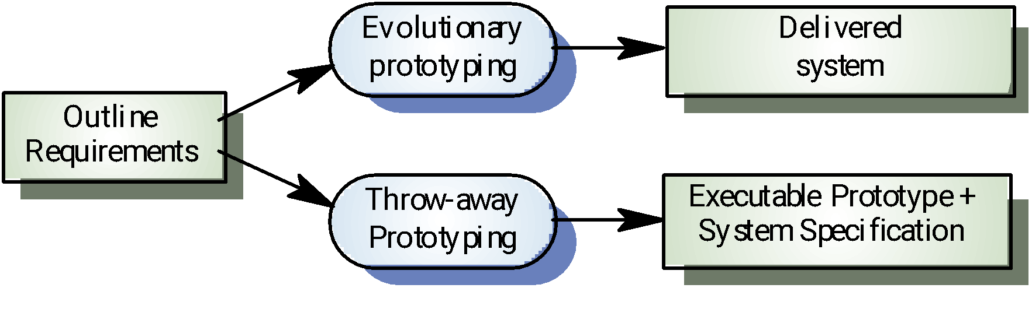
Approaches to prototyping

Slide 34
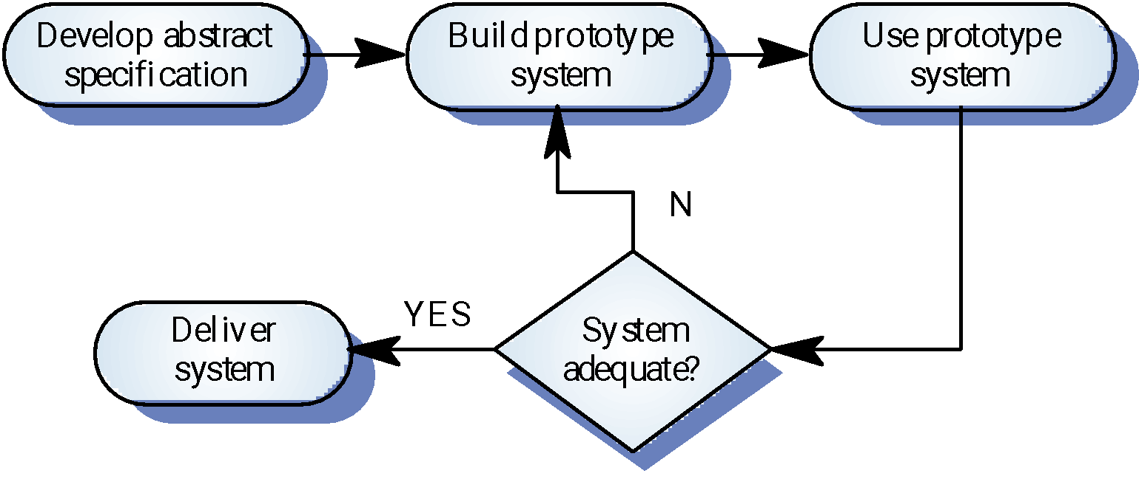
Evolutionary prototyping

Slide 35
Evolutionary prototyping advantages
Accelerated delivery of the system
Rapid delivery and deployment are sometimes more important than functionality or long-term software maintainability
User engagement with the system
Not only is the system more likely to meet user requirements, they are more likely to commit to the use of the system

Slide 36
Evolutionary prototyping problems
Management problems
Existing management processes assume a waterfall model of development
Specialist skills are required which may not be available in all development teams
Maintenance problems
Continual change tends to corrupt system structure so long-term maintenance is expensive
Contractual problems
Due to cost or time line agreed

Slide 37
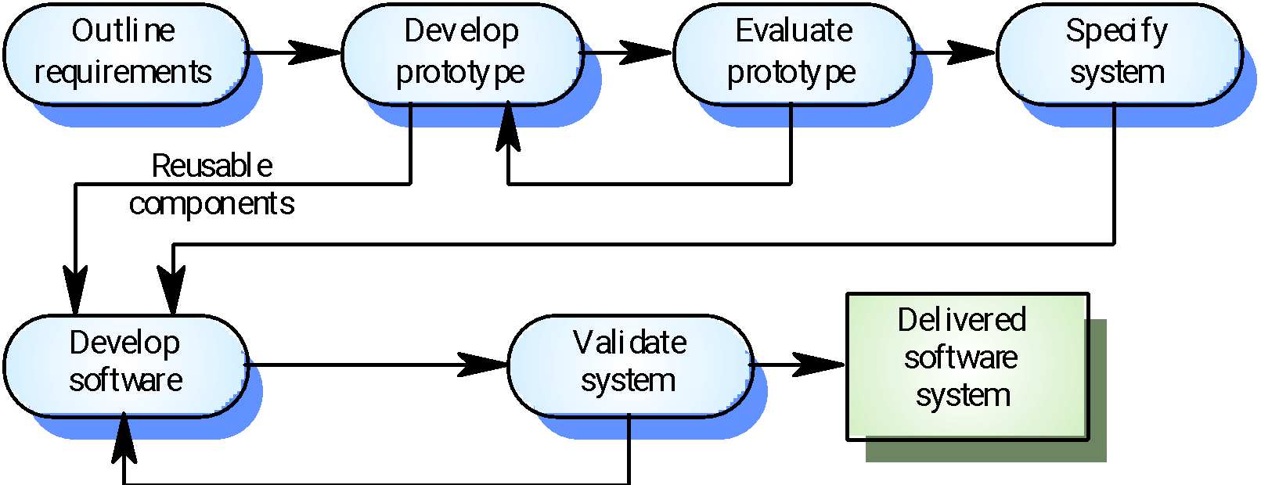
Throw-away prototyping

Slide 38
Throw-away prototyping
Used to reduce requirements risk
The prototype is developed from an initial specification, delivered for experiment then discarded
The throw-away prototype should NOT be considered as a final system
Some system characteristics may have been left out
There is no specification for long-term maintenance
The system will be poorly structured and difficult to maintain

Slide 39
Prototyping Methods and Tools
A prototype must be developed rapidly so that the customer may assess results and recommend changes.
3 methods are available:
Fourth Generation Techniques (4GT)
4GT enable the software engineer to generate executable code quickly, they are ideal for rapid prototyping.
Ex. Tool for Database query language or reporting language.
Reusable software components
To rapid prototyping is to assemble, rather than build, the prototype by using a set of existing software components.
Should maintain library for existing software components
An existing software product can be used as a prototype for a "new, improved" competitive product
Formal specification and prototyping environments
Enable an analyst to interactively create language-based specifications of a system or software,
Invoke automated tools that translate the language-based specifications into executable code,
Enable the customer to use the prototype executable code to refine formal requirements.

Slide 40
Specification
Mode of specification has much to do with the quality of solution.
If specification incomplete, inconsistent, or misleading specifications have experienced the frustration and confusion that invariably results.
Specification Principles: May be viewed as representation process.
Separate functionality from implementation.
Develop a model of the desired behavior of a system.
Establish the context in which software operates by specifying the manner.
Define the environment in which the system operates and indicate how.

Slide 41
Specification Principles (cont.)
Create a cognitive model rather than a design or implementation model. The cognitive model describes a system as perceived by its user community.
The specifications must be tolerant of incompleteness and augmentable.
Establish the content and structure of a specification in a way that will enable it to be amenable to change.

Slide 42
Specification Representation
Representation format and content should be relevant to the problem.
For example, a specification for a manufacturing automation system might use different symbology, diagrams and language than the specification for a programming language compiler.
Information contained within the specification should be nested (layered).
Paragraph and diagram numbering schemes should indicate the level of detail that is being presented.
It is sometimes worthwhile to present the same information at different levels of abstraction to aid in understanding.
Diagrams and other notational forms should be restricted in number and consistent in use.
Confusing or inconsistent notation, whether graphical or symbolic, degrades understanding and fosters errors.
Representations should be revisable.

Slide 43
Software Requirements Specification
It contains a complete information description, a detailed functional description, a representation of system behavior, an indication of performance requirements and design constraints, appropriate validation criteria, and other information pertinent to requirements.
Format of SRS:
Introduction of the software requirements specification states the goals and objectives of the software, describing it in the context of the computer-based system.
Information content, flow, and structure are documented. Hardware, software, and human interfaces are described for external system elements and internal software functions.
Functional Description A processing narrative is provided for each function, design constraints are stated and justified & performance characteristics are stated
Behavioral Description operation of the software as a consequence of external events and internally generated control characteristics.

Slide 44
Software Requirements Specification (Cont.)
Validation Criteria is probably the most important and, ironically, the most often neglected section of the Software Requirements Specification (SRS). Testing or validating each user-scenario.
Finally, the specification includes a Bibliography and Appendix. The bibliography contains references to all documents that relate to the software. The appendix contains information that supplements the specifications

Slide 45
Specification Review
A review of the SRS (and/or prototype) is conducted by both the software developer and the customer.
Conducted at a macroscopic level
Ensure that specification is complete
Consistent
Accurate (Information, functional and behavioral domain considered).
Review becomes more detailed while examining Information, functional and behavioral domain.
Examining not only broad descriptions but the way in which requirement worded.
E.g. Terms like “Vague ” (some, sometimes, often, usually) should be flag by reviewer for further clarification.

Slide 46
Review (cont.)
Once review is complete – SRS “signed off” by both customer and developer. ( “contract” for software development)
Requests for changes in requirements after the specification is finalized will not be eliminated.
Change is an extension of software scope and therefore can increase cost and/or delivery of product.
During the review, changes to the specification may be recommended.
It can be extremely difficult to assess the global impact of a change; that is, how a change in one function affects requirements for other functions

